Slide 1
Abstract Classes and Interfaces
Trainer – Danilo Borozan
Co-Trainer – Ilija Mitev

Slide 2
AGENDA
What are abstract classes
Difference between abstract and standard classes
Inheritance with abstract classes
What are interfaces
Difference between abstract class and interface

Slide 3
WHAT IS AN ABSTRACT CLASS?
Can’t create instances of abstract class
Used with inheritance
Can contain abstract methods that don’t have implementation
Can contain constructors, properties and methods with implementation
Used for business logic that does not make sense by it self

Slide 4
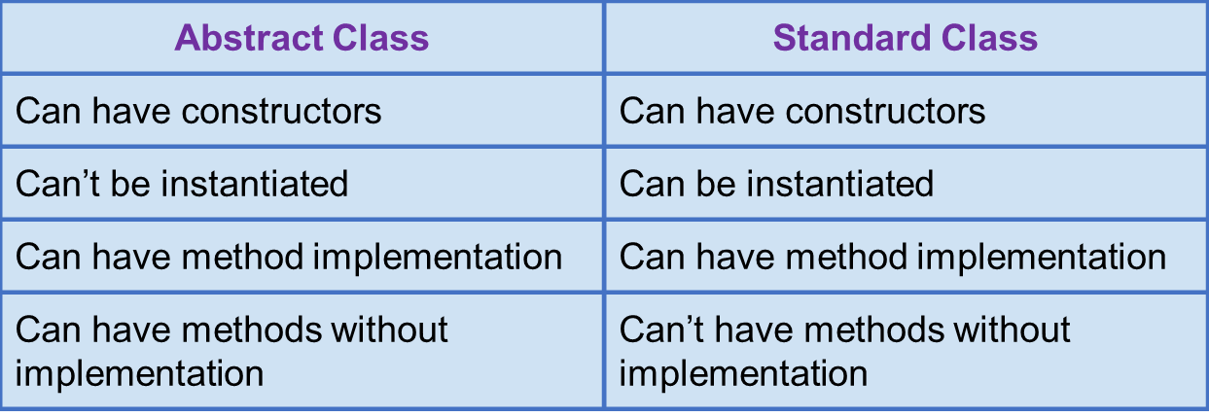
ABSTRACT VS STANDARD CLASS

Slide 5
WHAT IS AN INTERFACE?
An interface is not a class
Can’t create instances of interfaces
It can’t contain any implementation
It can’t contain access modifiers
It can only contain the structure of a class
An entity can inherit from multiple interfaces
It is sort of like a ruleset that when inherited from, will make sure that that entity implements the rules

Slide 6
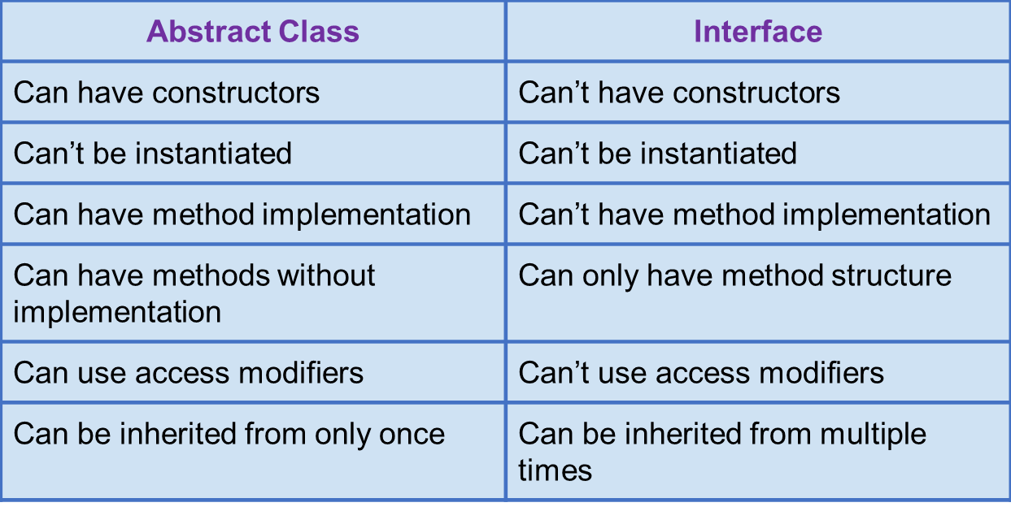
ABSTRACT CLASS VS INTERFACE

Slide 7
WHERE AND WHEN TO USE THEM
Abstract classes are usually used for setting a base class with some base logic so that other classes don’t repeat some generic and universal logic
Interfaces are usually used for making pieces of logic less dependent on one another by using the base rules for a class that we need instead of the class itself so we are less dependent on it
Standard classes are usually used for setting up base models for our business logic

Slide 8
BOXING AND UNBOXING
Boxing/Unboxing allow us to convert data types from value type to reference type and vice versa
The process of converting types from value type to reference type is called Boxing (int -> object)
The reverse process of turning a reference type into value type is called Unboxing

Slide 9
01
EXERCISE
Create interfaces called IUser, IStudent, ITeacher
IUser : PrintUser() - Prints Id, Name and Username
IStudent: PrintGrades() – Prints the student grades
ITeacher : PrintSubjects() – Prints the subjects
Create an abstract class User that inherits from IUser
Create a class Student that inherits from User and IStudent. Override PrintUser() to additionaly show average grade.
Create a class Teacher that inherits from User and ITeacher. Override PrintUser() to show the count of subjects
Create 2 teacher and 2 student objects and call PrintUser() on all of them

Slide 10
QUESTIONS?
You can find us at
daniloborozan07@gmail.com
ilija.mitev3@gmail.com

